Slide 1


Notes:
Join the conversation here: http://discuss.hashicorp.com

Slide 2

Advanced Terraform Techniques
code reuse / data-driven code for_each > count / implicit dependencies

Slide 3




John McDonough
Cloud Architect at @johnamcdonough movinalot

Slide 4

Agenda
HashiTalks Hello!
Advanced Terraform Techniques
code reuse
data-driven code
for_each > count
implicit dependencies
Repo - https://github.com/movinalot/hashitalks-2023
John McDonough – Fortinet

Slide 5

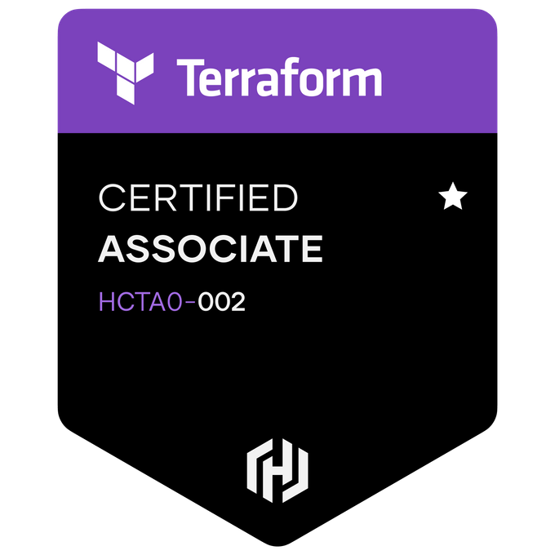
HashiTalks 2023 – Hello!
John McDonough
Cloud Architect / DevOps Engineer – Fortinet
{ location: "new_jersey", employer: "fortinet, inc." hobbies: ["terraform", "fitness", "kites"] demographics: { spouse: 1 children: 3 pets: { cats: 1 } } }
John McDonough – Fortinet

Slide 6
code reuse

Slide 7
code reuse – git submodules
A submodule is a regular repository
Added to your repository as a reference
Submodule code is in a directory at or below root
One or more submodules can be added
.gitmodules is added in root to track all submodules
https://git-scm.com/book/en/v2/Git-Tools-Submodules
John McDonough – Fortinet

Slide 8
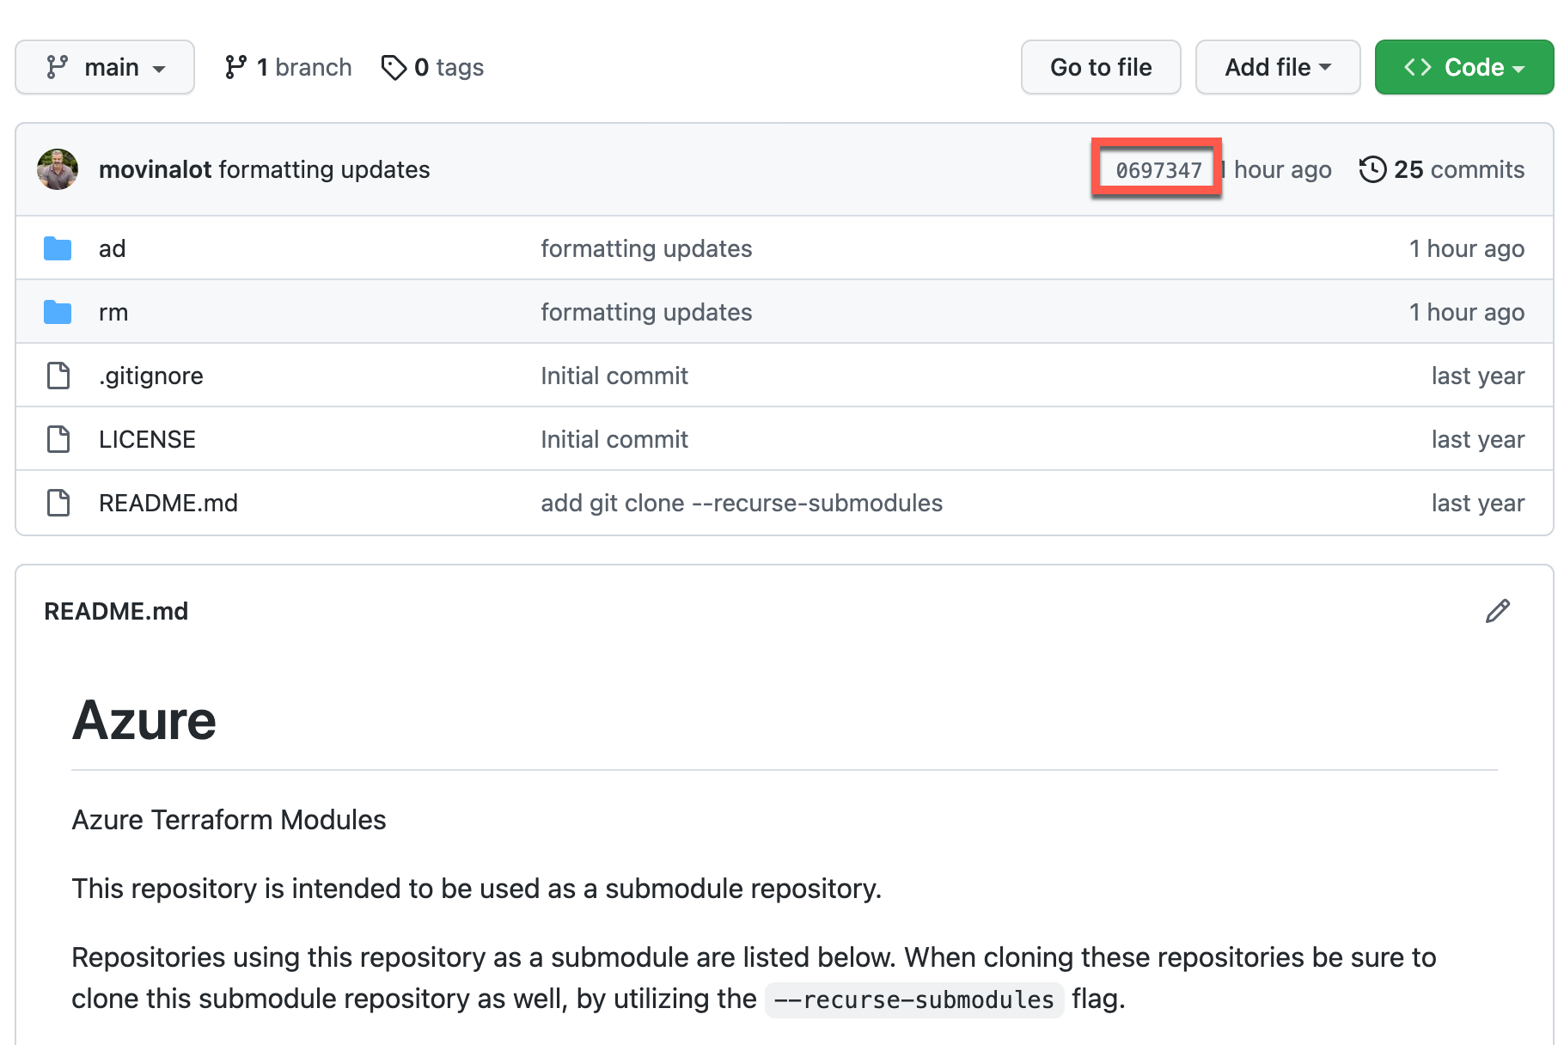
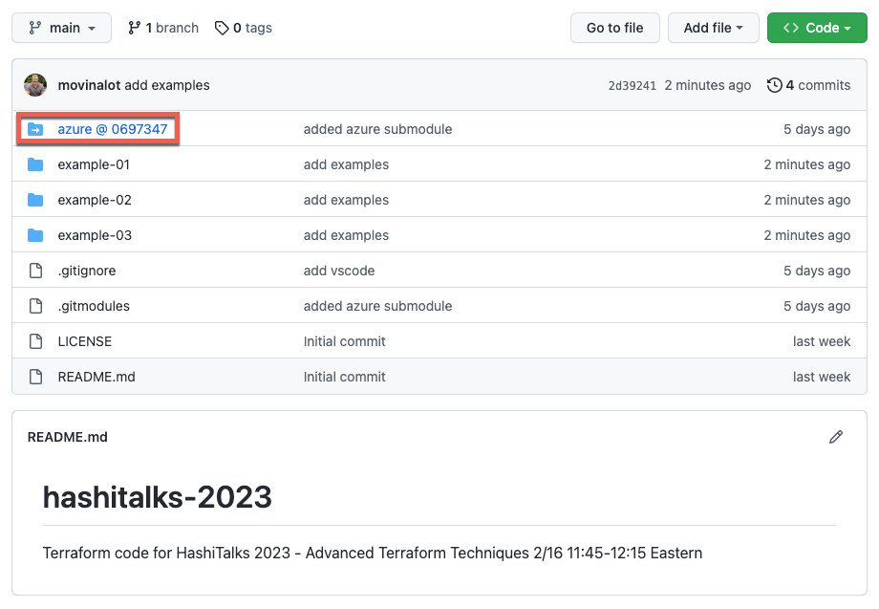
code reuse – git submodules
The SHA number indicates the repo commit
John McDonough – Fortinet

Slide 9
code reuse – git submodules Terraform code
Keep generic resource code in a git repository
Add as a submodule to projects
resource module is a distinct object
resource output is a single object
All attributes are variables
variables.tf defines defaults, descriptions, validations
John McDonough – Fortinet

Slide 10
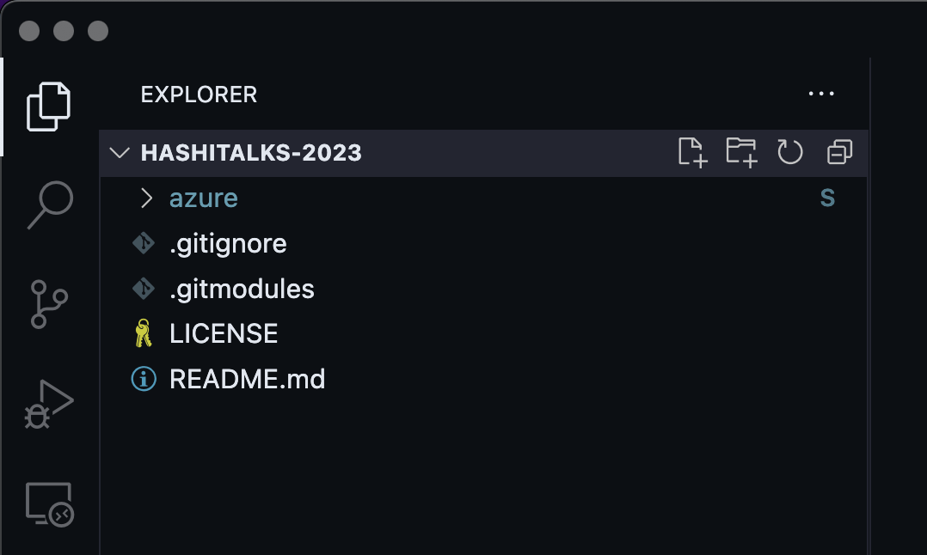
code reuse – git submodule commands
In your repo
$ git submodule add <remote_url> [ <destination_folder> ]
$ git commit -m "added submodule"
$ git push
when submodule is updated
pull / commit / push - sub
commit / push - main
John McDonough – Fortinet

Slide 11
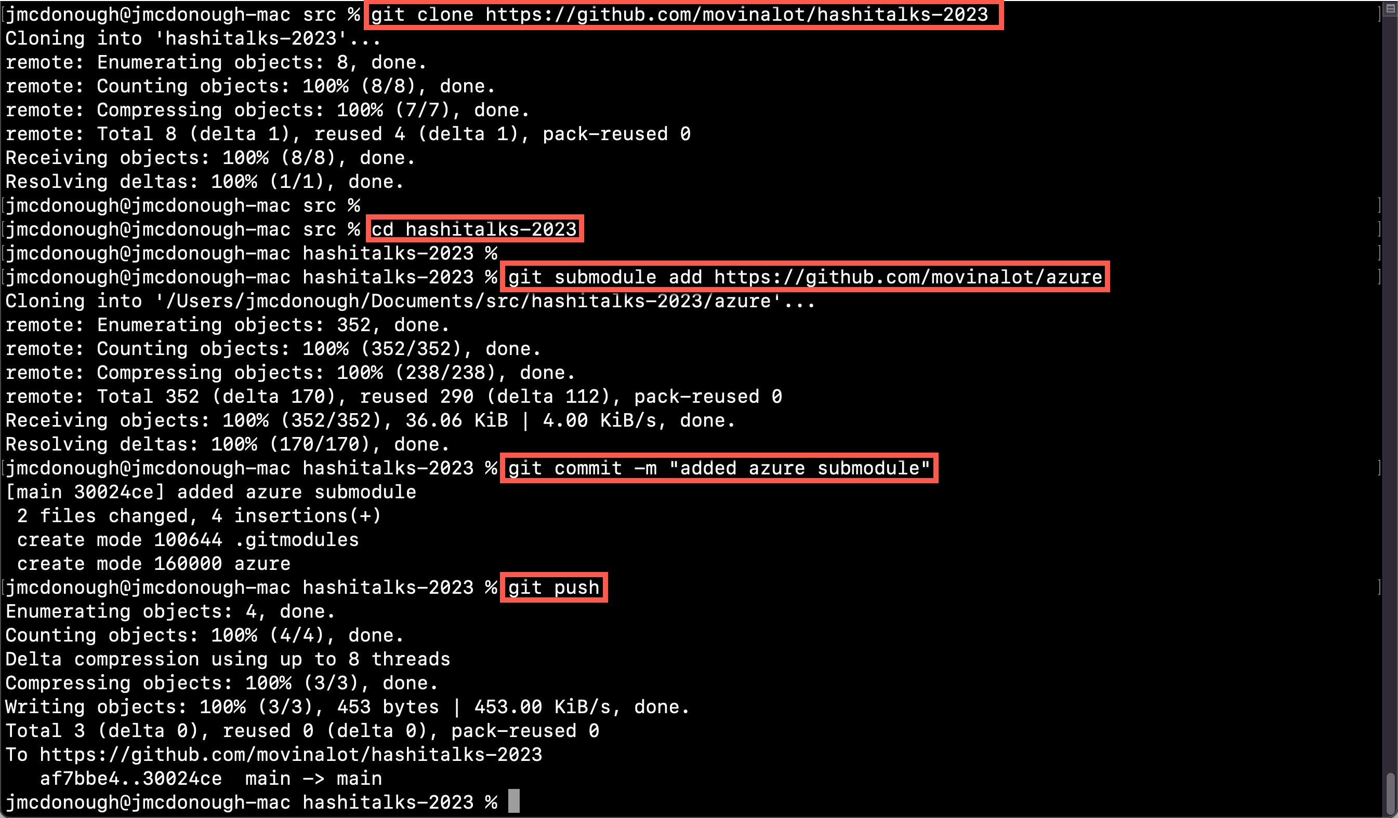
code reuse – git submodule commands
John McDonough – Fortinet

Slide 12
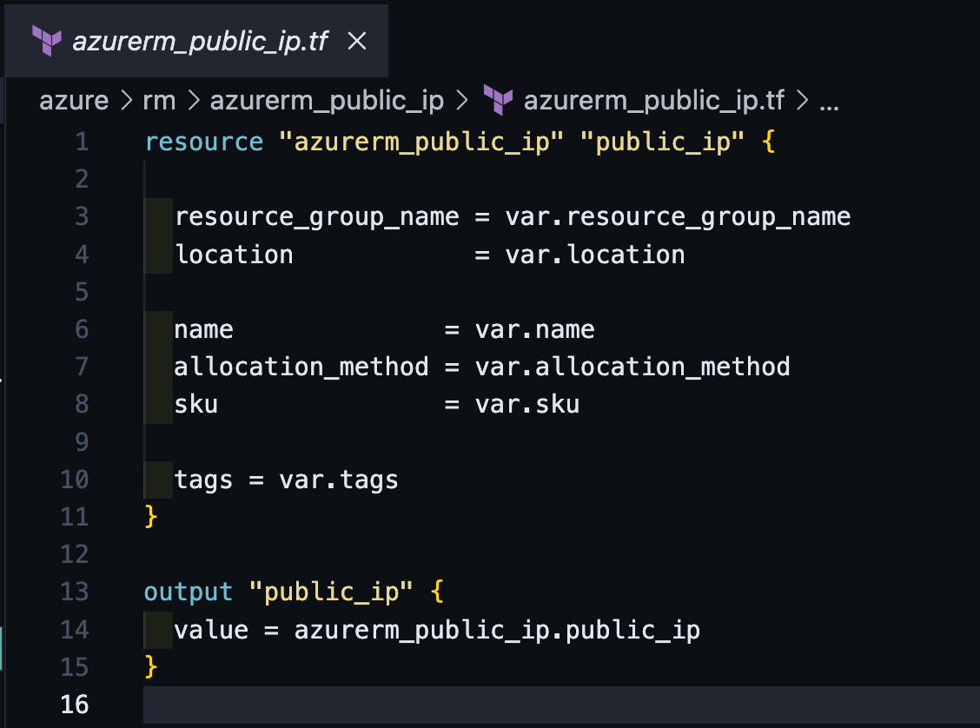
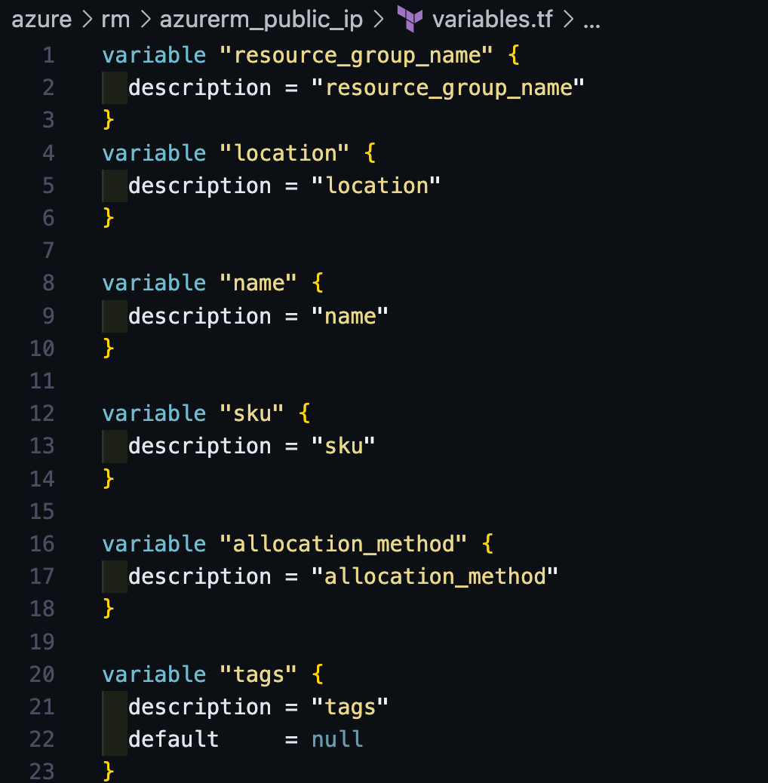
code reuse – generic modules
John McDonough – Fortinet

Slide 13
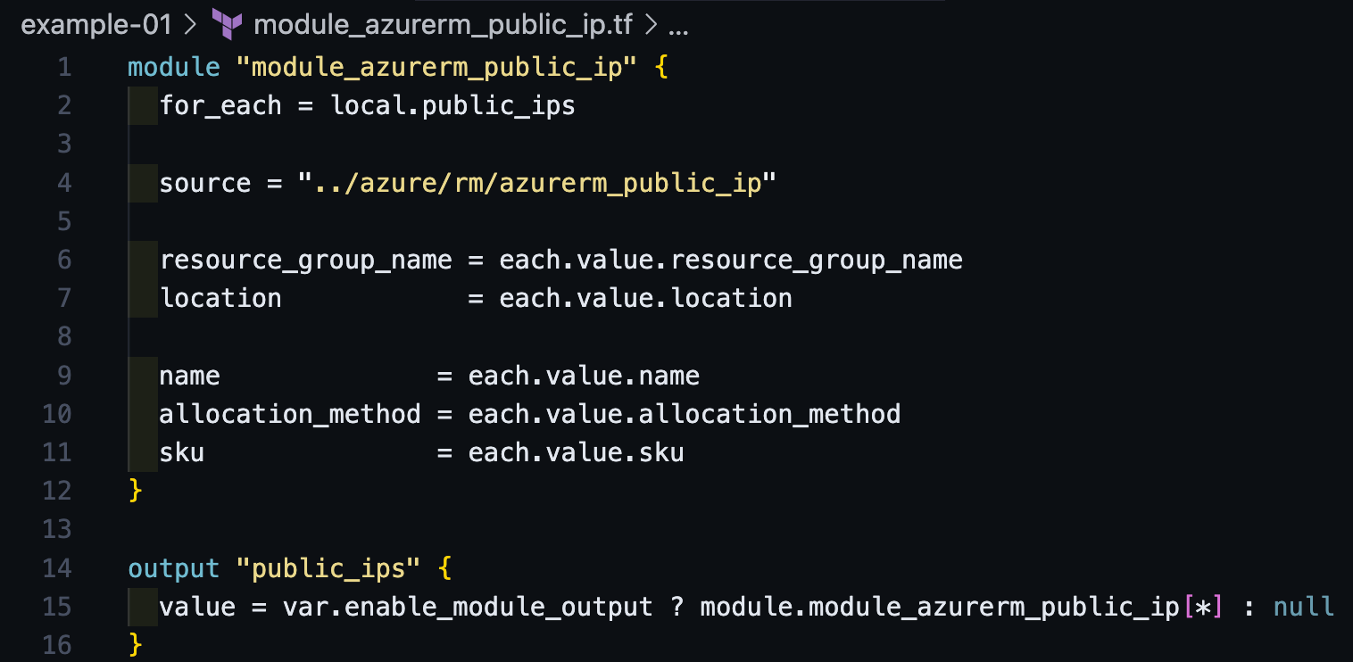
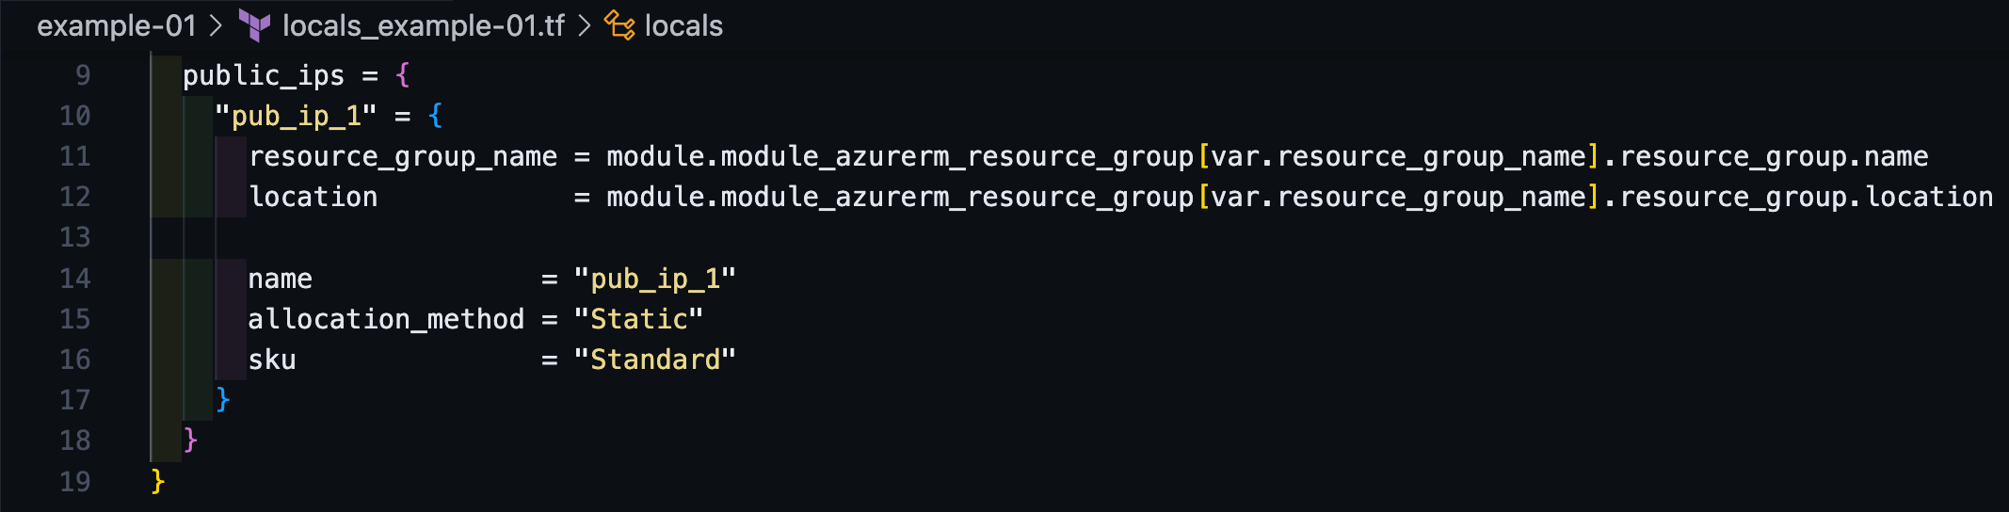
code reuse – modules & locals
Module
Generic Resource
Locals
John McDonough – Fortinet

Slide 14
data-driven code

Slide 15
data-driven code – modules & locals
John McDonough – Fortinet

Slide 16
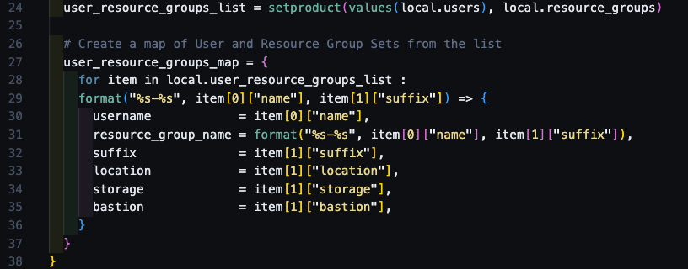
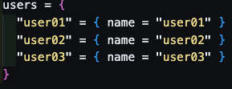
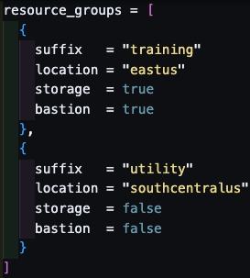
data-driven code – maps & lists
John McDonough – Fortinet

Slide 17
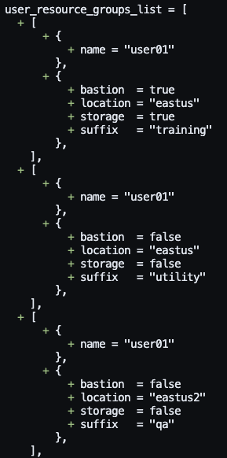
data-driven code – maps & lists
John McDonough – Fortinet

Slide 18
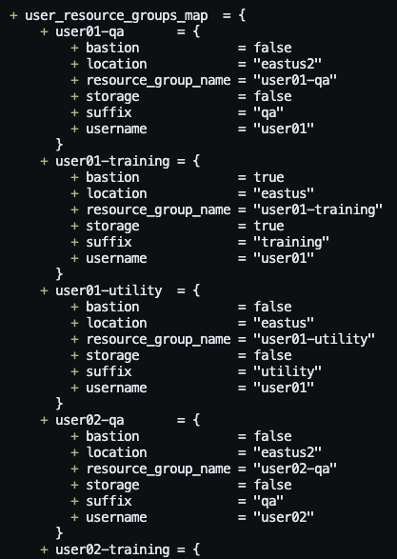
data-driven code – maps & lists
John McDonough – Fortinet

Slide 19
for_each > count

Slide 20

for_each > count
count = #
count = var.deploy_bastion ? 1 : 0
count = length(var.resource_groups)
object are identified by their index
Terraform docs state that count is fine for similar items
Don’t use count!
count
John McDonough – Fortinet

Slide 21
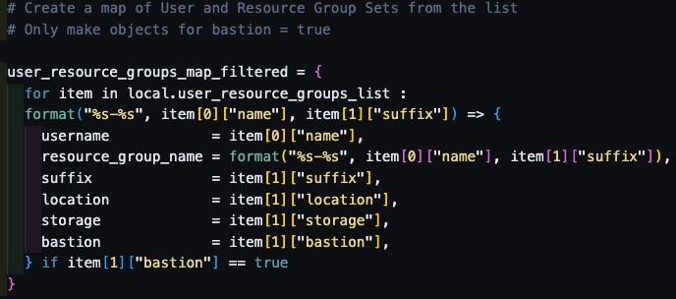
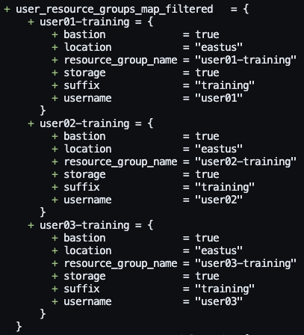
for_each > count – conditional object creation
John McDonough – Fortinet

Slide 22
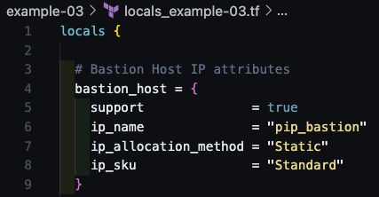
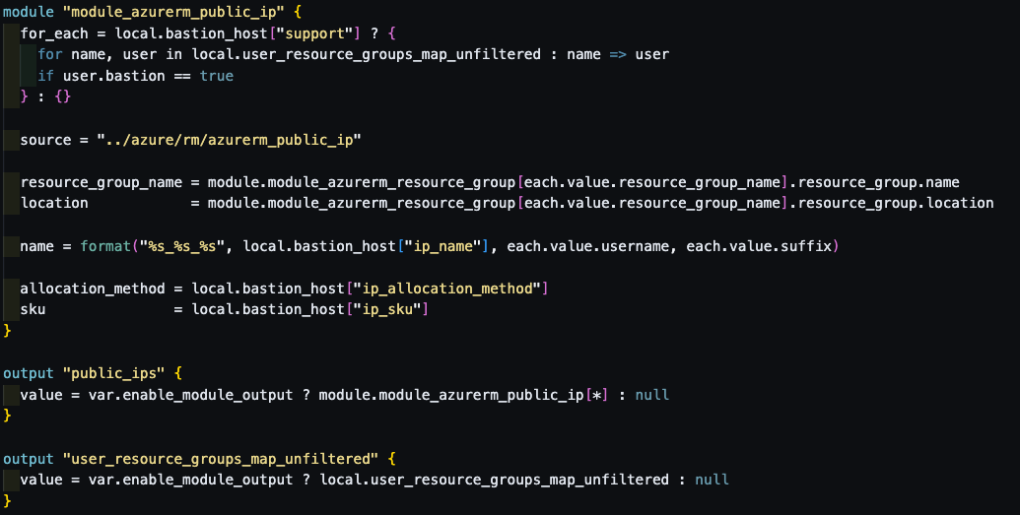
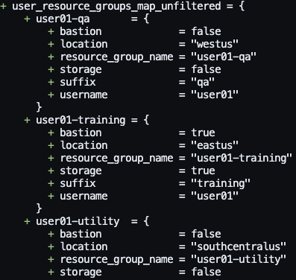
for_each > count – conditional object utilization
John McDonough – Fortinet

Slide 23
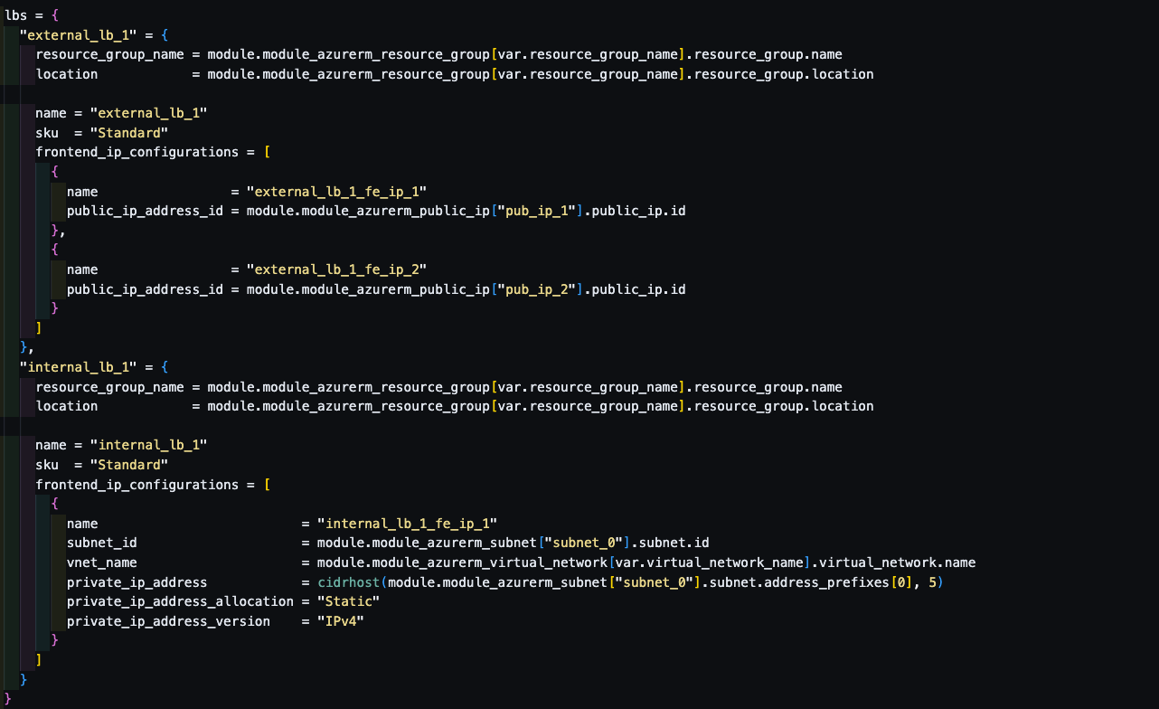
for_each > count – dynamic blocks - locals
John McDonough – Fortinet

Slide 24
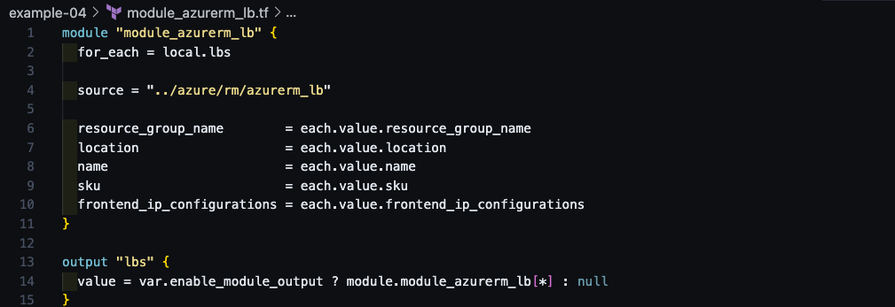
for_each > count – dynamic blocks - module
John McDonough – Fortinet

Slide 25
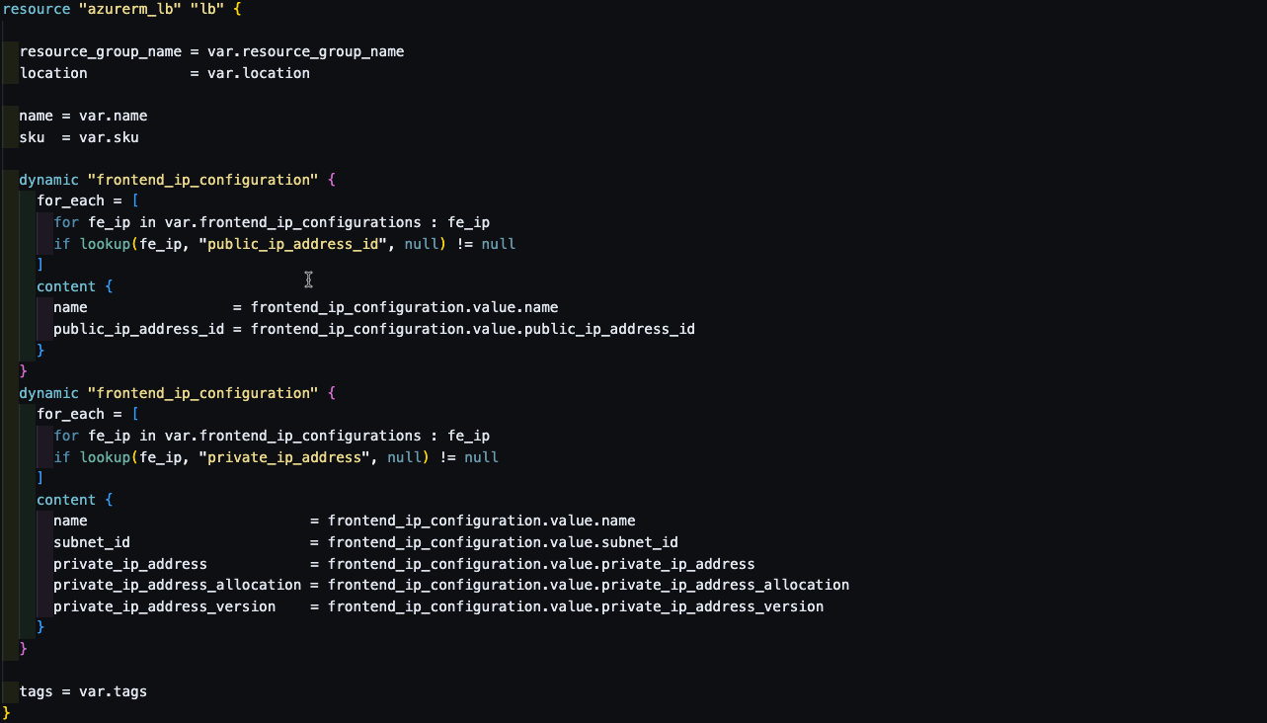
for_each > count – dynamic blocks - resource
John McDonough – Fortinet

Slide 26
implicit dependencies

Slide 27
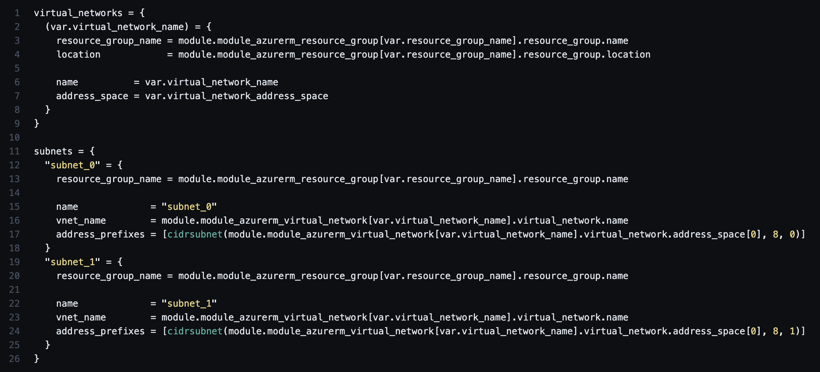
implicit dependencies - when possible
John McDonough – Fortinet

Slide 28
Thank You
hugs@hashicorp.com | learn.hashicorp.com | discuss.hashicorp.com

Slide 29
hugs@hashicorp.com | learn.hashicorp.com | discuss.hashicorp.com
Notes:
Speaker’s Note: Thank you for attending our Meetup! We hope you stay in touch and hope to see you at our next Meetup. Until then, stay engaged with the rest of the community in the HashiCorp Community Forum. Friendly reminder that you can register for HashiConf EU using the HUG community 20% discount until late registration ticket sales begin.
Here is the code: PENDING.
Here is the community forum: discuss.hashicorp.com

